Slide 1
ENG 346 Data Structures and Algorithms for Artificial Intelligence Tkinter
Dr. Mehmet PEKMEZCİ
mpekmezci@gtu.edu.tr

Slide 2
What widgets TKinter provide?
button
canvas
checkbutton
combobox
entry
frame
label
labelframe
listbox
menu
menubutton
message
notebook
tk_optionMenu
panedwindow
progressbar
radiobutton
scale
scrollbar
separator
sizegrip
spinbox
text
treeview

Slide 3
Also…
tk_chooseColor - pops up a dialog box for the user to select a color.
tk_chooseDirectory - pops up a dialog box for the user to select a directory.
tk_dialog - creates a modal dialog and waits for a response.
tk_getOpenFile - pops up a dialog box for the user to select a file to open.
tk_getSaveFile - pops up a dialog box for the user to select a file to save.
tk_messageBox - pops up a message window and waits for a user response.
tk_popup - posts a popup menu.
toplevel - creates and manipulates toplevel widgets.

Slide 4
Tk has three geometry managers:
place - which positions widgets at absolute locations
grid - which arranges widgets in a grid
pack - which packs widgets into a space

Slide 5
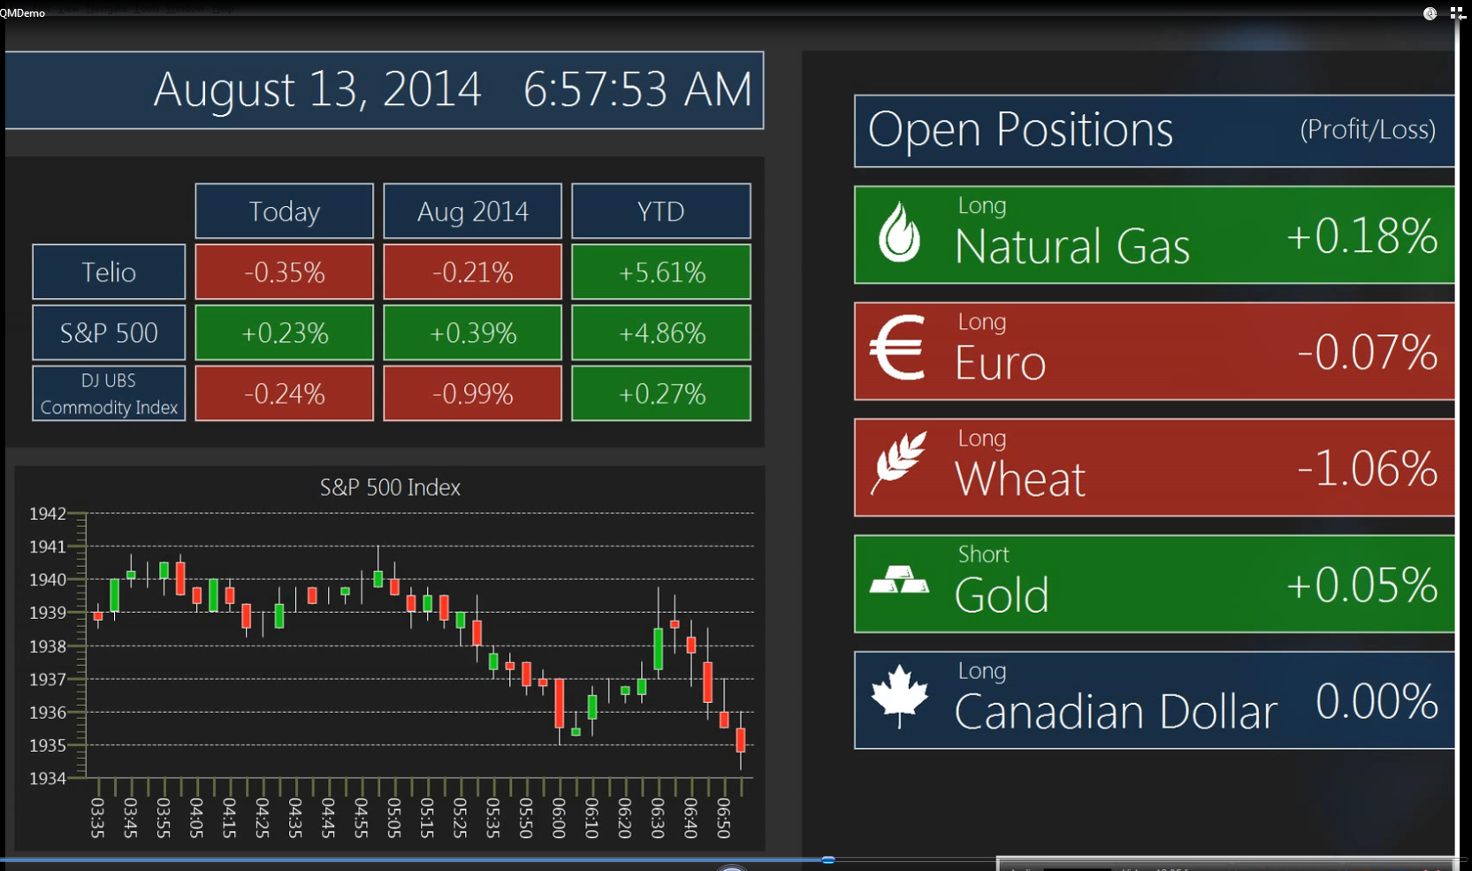
To start
import tkinter as tk
or:
from tkinter import *

Slide 6
import tkinter
The first widget (window object) that must be set up is the ‘root’ widget
root = Tk()
There can only be one root widget in a program.
A top level window is sometimes referred to as a ‘master’

Slide 7
Then…
Once the root is in place we can use other widgets each has to be instantiated as a child of the root
introlabel = Label(root, text="Hello Tkinter!")
Widgets inside the window are sometimes referred to as ‘slaves’.

Slide 8
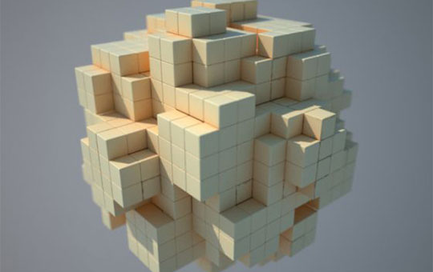
Geometry…
We need to place the widget in the window.
TK has 3 built-in geometry managers
place() − This organizes widgets by placing them in a specific position in the parent.
pack() − This organizes widgets in blocks before placing them in the parent.
grid(column, row, sticky) − This organizes widgets in a table-like structure in the parent.

Slide 9
Place
widget.place( place_options )
anchor − The exact spot of widget other options refer to: may be N, E, S, W, NE, NW, SE, or SW, compass directions indicating the corners and sides of widget; default is NW (the upper left corner of widget)
bordermode − INSIDE (the default) to indicate that other options refer to the parent's inside (ignoring the parent's border); OUTSIDE otherwise.
height, width − Height and width in pixels.
relheight, relwidth − Height and width as a float between 0.0 and 1.0, as a fraction of the height and width of the parent widget.
relx, rely − Horizontal and vertical offset as a float between 0.0 and 1.0, as a fraction of the height and width of the parent widget.
x, y − Horizontal and vertical offset in pixels

Slide 10
Pack
widget.pack( pack_options )
expand − When set to true, widget expands to fill any space not otherwise used in widget's parent.
fill − Determines whether widget fills any extra space allocated to it by the packer,
or keeps its own minimal dimensions: NONE (default), X (fill only horizontally), Y (fill only vertically), or BOTH (fill both horizontally and vertically).
side − Determines which side of the parent widget packs against:
TOP (default), BOTTOM, LEFT, or RIGHT.

Slide 11
Grid
widget.grid( grid_options )
column − The column to put widget in; default 0 (leftmost column).
columnspan − How many columns the widget occupies; default 1.
padx, pady − How many pixels to pad widget, horizontally and vertically, outside a widget’s borders.
ipadx, ipady −How many pixels to pad widget, horizontally and vertically, inside a widget's borders.
row − The row to put awidget in; default the first row that is still empty.
rowspan − How many rows widget occupies; default 1.
sticky − What to do if the cell is larger than widget. By default, a widget is centered in its cell. Sticky may be the string concatenation of zero or more of N, E, S, W, NE, NW, SE, and SW, compass directions indicating the sides and corners of the cell t which widget sticks.

Slide 12
Then What?
To run the program we must create enter the event loop
root.mainloop()
This will keep the window open until we close it.

Slide 13
Let’s try this!
https://www.tutorialspoint.com/python3/python_gui_programming.htm

